Slide 1
Unsupervised Learning
David Quigley
CSCI 4622
2022 Spring

Slide 2

Course Logistics
Problem Set 4: 4/4 @ 11:59PM
Late submissions are still accepted, but Kaggle does not have a good process for this!
If you are looking to submit late, please email and we can go through the process
Late submissions will not be eligible for the “top 25%” Bonus Points
Will be eligible for the >.70 bonus points
Project Milestone 3: Due 4/8
Just a check-in, integrating feedback, etc.

Slide 3
An Application of Clustering
What I did last Summer

Slide 4
An Application of Clustering
What One portion of one of the projects I did last Summer a few years ago
Presented at Learning Analytics & Knowledge 2020

Slide 5
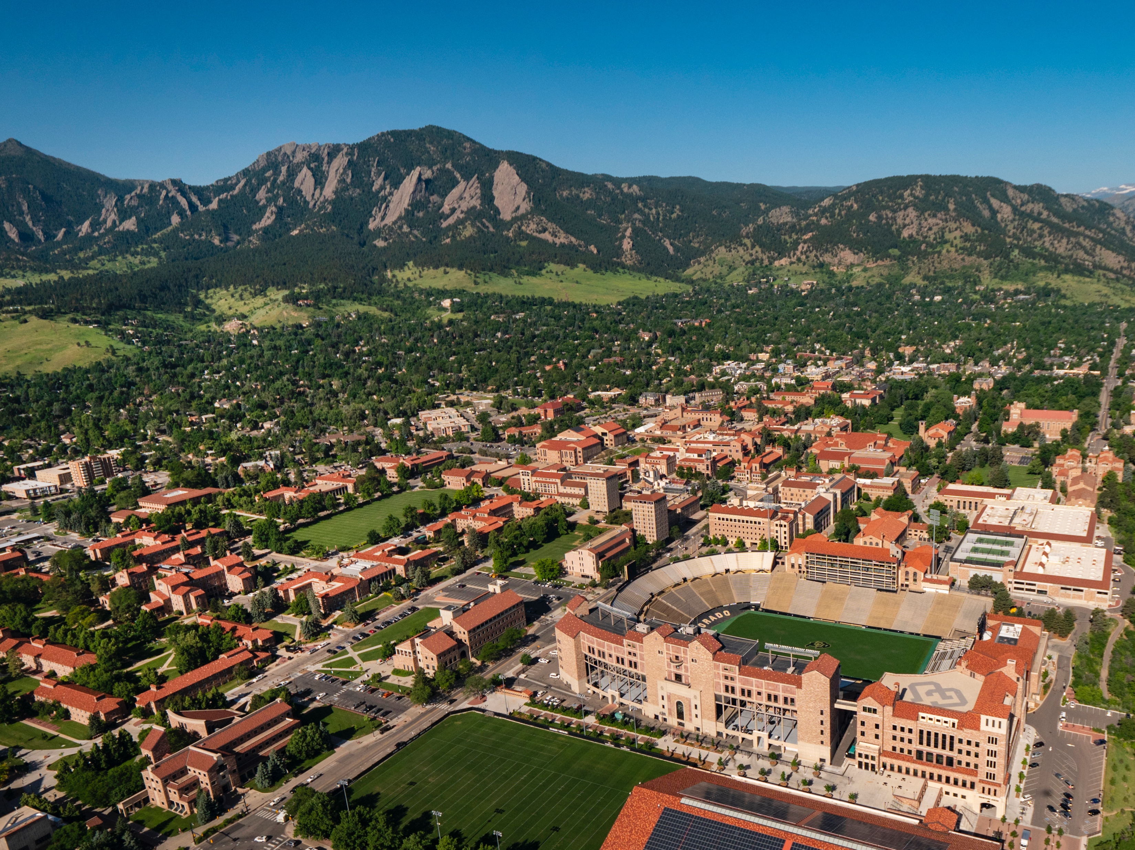
Trace Data from Student Solutions to Genetics Problems Reveals Variance in the Processes Related to Different Course Outcomes
Melanie E. Peffer, David Quigley, Liza Brusman, Jennifer Avena, Jennifer Knight
2020 Learning Analytics and Knowledge Conference
March 25, 2020
Please Tweet Questions/Comments! @Melanie_Peffer
Notes:
Thank you for attending my talk today! I’m very excited to share some of the work I’ve been doing at University of Colorado Boulder on how students solve genetics problems and how learning analytics can be used to generate new insights into student’s problem solving practices. To start, why do we care about genetics learning?

Slide 6
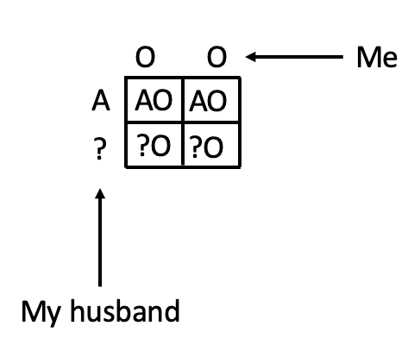
Problem Solving is Integral to Genetics Literacy
Problem Solving: process of finding a solution to an unstructured or complex situation
Genetics relies heavily on problem solving
No longer limited to classrooms
Problem solving tends to be difficult for students
Genetics problem solving is particularly challenging
https://www.technologynetworks.com/genomics/articles/genotype-vs-phenotype-examples-and-definitions-318446
@Melanie_Peffer
Notes:
Genetics is tough because of the necessity to reason across a variety of spatial levels, abductive reasoning (working backwards), usage of math/algebra, proportional reasoning, understanding of basic statistics (odds ratios)

Slide 7
Three Level Model of Processing During Problem Solving (Hofer, 2004)
Cognition
(Reading, Gathering Information)
Epistemic Cognition
Metacognition
(Reflecting, Planning, Monitoring)
@Melanie_Peffer
Notes:
Metacognition—crucial link for successful problem solving. Connects what learners know to how they think so that this can be applied to successful problem solving

Slide 8
Technological Solutions to Measuring Latent Constructs
Measurement of cognition via student traces
Epistemological beliefs about science as seen through inquiry practices
Expert/Novice studies of inquiry (Peffer & Ramezani, 2019)
Use of learning analytics for assessment of epistemological beliefs
NLP of discourse during inquiry (Peffer & Kyle, 2017; LAK ‘17 Best Paper Nominee)
K-means clustering of inquiry profiles (Peffer, Quigley, and Mowstofi, 2019; LAK ‘19)
@Melanie_Peffer
Notes:
Look at what students do as a proxy for how they are thinking/what they believe (stealth assessment)
Not a new idea—has been presented at LAK in the past
What about specifically in the context of problem solving?

Slide 9
Current Study
Working knowledge of genetics and ability to solve genetics problems is crucial in today’s society
Metacognition is a crucial skill in successful problem solving, but is difficult to measure
Prior work suggests that trace data can be used to understand latent constructs
Can trace data reveal cognitive processes in action during genetics problem solving?
@Melanie_Peffer

Slide 10
Methods
Participants
n = 295 undergraduate introductory genetics students
Intervention
Extra credit genetics problems
“Think aloud” protocol while solving
Outputs
Problem correctness
Genetics Concept Assessment (Smith, Wood, and Knight, 2008)
Final exam score
@Melanie_Peffer

Slide 11
Analysis
Coding
Emergent coding approach
Identified 19 processes that fell under 5 categories
@Melanie_Peffer

Slide 12

Methods
Category | Subcategories
Conclusion | Eliminating, Claiming
Metacognition | Monitoring, Checking, Planning
Orientation | Clarifying, Recalling Information, Identifying similarities between question types
Reasoning | Justifying answers with evidence, reasoning
Execution | Using Information, Calculating, Creating a visual representation, Restating the process
@Melanie_Peffer

Slide 13
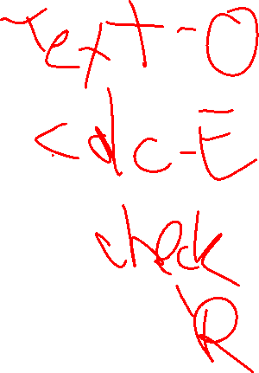
Analysis
Coding
Emergent coding approach
Identified 19 processes that fell under 5 categories
Feature Transformation
Each process assigned a single letter code (CMORE)
Sequences of processes generated
Built counts of all possible action bigrams to capture sequences
Cluster Analysis
K-means clustering using Weka
Built clusters using bigram features
Cluster assignment related to outcomes
@Melanie_Peffer
Notes:
Final number of clusters decided using elbow method

Slide 14
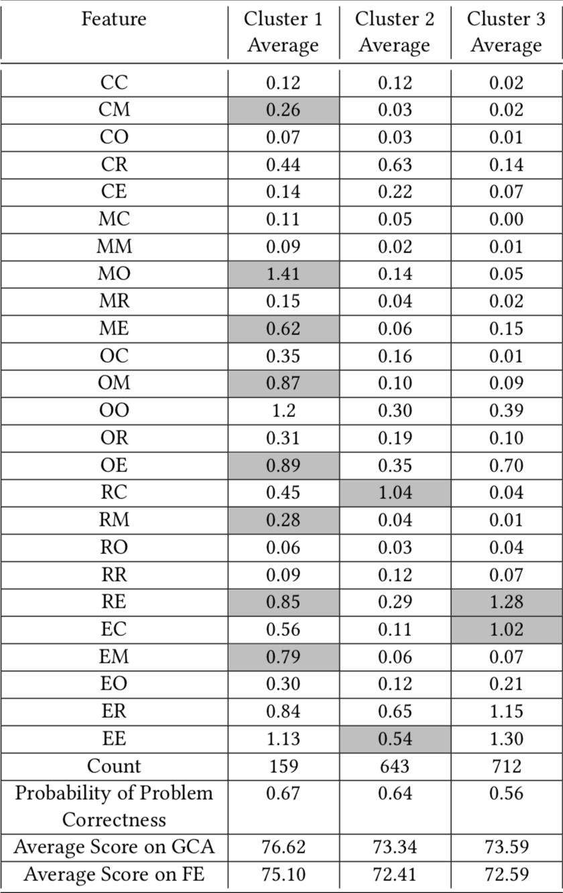

Bigram Clustering Reveals Differences in Processes and Probability of Answering Problems Correctly
C=conclusion, M=metacognition, O=Orientation, R=Reasoning, E=Execution
@Melanie_Peffer
Notes:
Centroids for each feature, distribution of outcome variables

Slide 15
Bigram Clustering Reveals Differences in Processes and Probability of Answering Problems Correctly
C=conclusion, M=metacognition, O=Orientation, R=Reasoning, E=Execution
@Melanie_Peffer
Notes:
Found three clusters

Slide 16
Bigram Clustering Reveals Differences in Processes and Probability of Answering Problems Correctly
C=conclusion, M=metacognition, O=Orientation, R=Reasoning, E=Execution
@Melanie_Peffer
Notes:
Cluster 1: Smallest, had the most CM, MO, ME, OM, OE, RM, RE, EM steps (highlighted)

Slide 17
Bigram Clustering Reveals Differences in Processes and Probability of Answering Problems Correctly
C=conclusion, M=metacognition, O=Orientation, R=Reasoning, E=Execution
@Melanie_Peffer
Notes:
Cluster 2: RC, EE steps, similar probability of getting the problem correct, but lower scores on GCA and FE

Slide 18

Bigram Clustering Reveals Differences in Processes and Probability of Answering Problems Correctly
C=conclusion, M=metacognition, O=Orientation, R=Reasoning, E=Execution
@Melanie_Peffer
Notes:
Cluster 3: RE, EC – lowest probability of getting problem correct (statistically significant)

Slide 19

NLP Primer
Or – Everything* You Need To Know About Natural Language Processing
*just kidding – go take 5832 if this sparks your interest!

Slide 20
NLTK – the SKLearn of NLP
https://www.nltk.org/

Slide 21
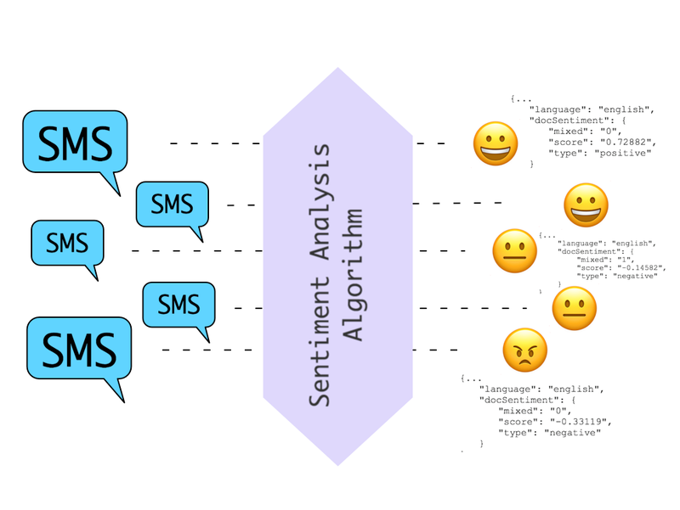
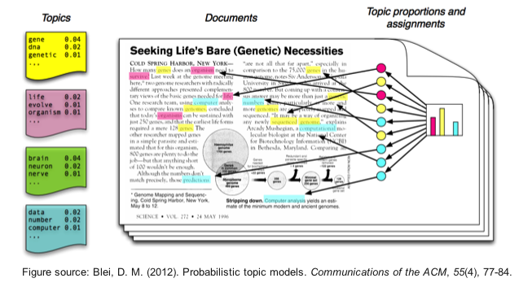

Natural Language Processing – Applications
Sentiment Analysis Topic Modeling
Translation
Notes:
https://machinelearningmastery.com/applications-of-deep-learning-for-natural-language-processing/
https://s3.amazonaws.com/com.twilio.prod.twilio-docs/images/SentimentAnalysis.width-800.png
http://bigdata.ices.utexas.edu/wp-content/uploads/2015/01/LDA-concept.png
https://www.fbi.gov/image-repository/translation-keyboard-stock.jpg/@@images/image/large

Slide 22
Natural Language Processing – Applications
Sentiment Analysis Topic Modeling
Translation
Notes:
https://machinelearningmastery.com/applications-of-deep-learning-for-natural-language-processing/
https://s3.amazonaws.com/com.twilio.prod.twilio-docs/images/SentimentAnalysis.width-800.png
http://bigdata.ices.utexas.edu/wp-content/uploads/2015/01/LDA-concept.png
https://www.fbi.gov/image-repository/translation-keyboard-stock.jpg/@@images/image/large

Slide 23
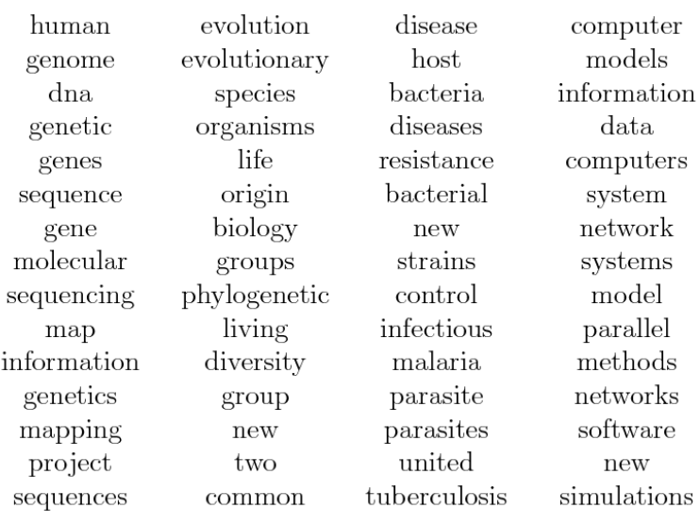
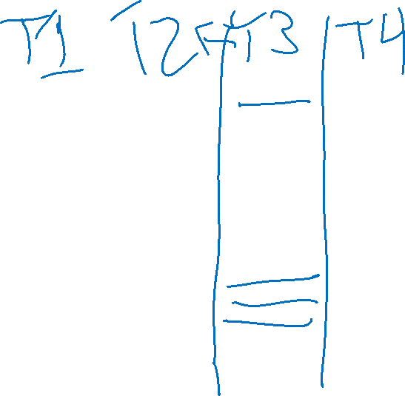
Topic Modeling
Clustering Technique
Associate similar documents
Example: Topics in Science

Slide 24
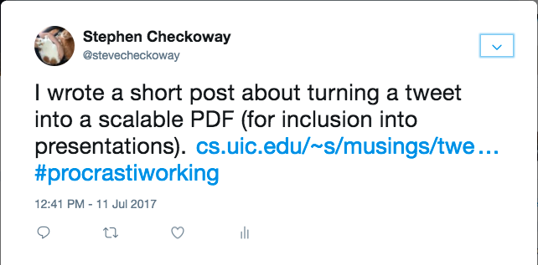
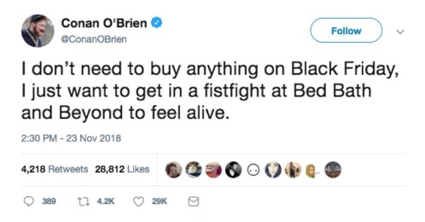

NLP Primer – Documents
Notes:
https://checkoway.net/assets/posts/tweet-images/tweet.png
https://i0.wp.com/bestlifeonline.com/wp-content/uploads/2018/12/conan-tweet.jpg?fit=498%2C260&ssl=1

Slide 25
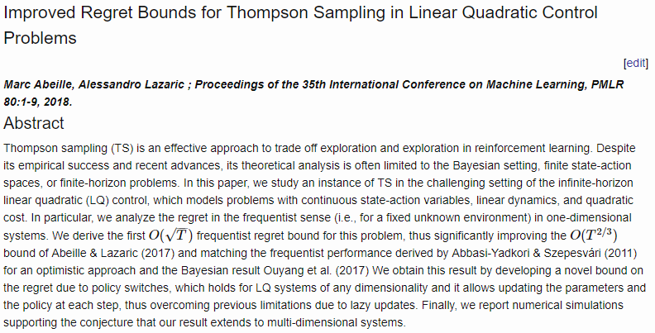
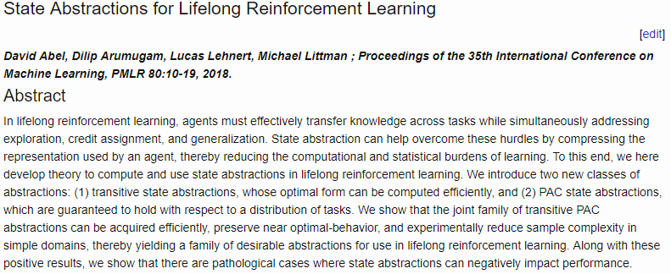
NLP Primer – Documents
Notes:
https://checkoway.net/assets/posts/tweet-images/tweet.png
https://i0.wp.com/bestlifeonline.com/wp-content/uploads/2018/12/conan-tweet.jpg?fit=498%2C260&ssl=1
http://proceedings.mlr.press/v80/abeille18a.html
http://proceedings.mlr.press/v80/abel18a.html

Slide 26
NLP Primer – Documents
Your definition of a “document” may vary, but it’s essentially one example in your problem!
- Tweet
- Article
- Paragraph
- Short-answer Response
Notes:
https://checkoway.net/assets/posts/tweet-images/tweet.png
https://i0.wp.com/bestlifeonline.com/wp-content/uploads/2018/12/conan-tweet.jpg?fit=498%2C260&ssl=1
http://proceedings.mlr.press/v80/abeille18a.html
http://proceedings.mlr.press/v80/abel18a.html

Slide 27
NLP Primer – Documents
Your definition of a “document” may vary, but it’s essentially one example in your problem!
- Tweet
- Article
- Paragraph
- Short-answer Response
Let’s look at clustering tweets
Notes:
https://checkoway.net/assets/posts/tweet-images/tweet.png
https://i0.wp.com/bestlifeonline.com/wp-content/uploads/2018/12/conan-tweet.jpg?fit=498%2C260&ssl=1
http://proceedings.mlr.press/v80/abeille18a.html
http://proceedings.mlr.press/v80/abel18a.html

Slide 28
NLP Primer – Documents into Features
Extracting metadata features
- references (retweets, links, other articles)
- author / source

Slide 29
NLP Primer – Documents into Features
Cleaning & Preparing Text
- Tokenization

Slide 30
NLP Primer – Tokenization
Breaking down block of text into subtexts
Typically filtering out all punctuation
- Or you include it as a token in the series
Notes:
http://blog.xnextcon.com/wp-content/uploads/2018/04/1.jpeg

Slide 31
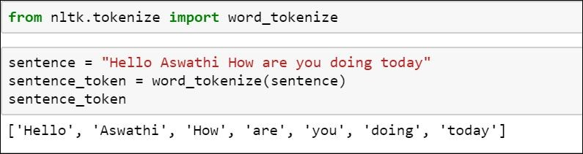

NLP Primer – Tokenization
Breaking down block of text into subtexts
Typically filtering out all punctuation
- Or you include it as a token in the series
May need to retain other structures (e.g. translation)
Notes:
http://blog.xnextcon.com/wp-content/uploads/2018/04/1.jpeg

Slide 32
NLP Primer – Documents into Features
Cleaning & Preparing Text
- Tokenization

Slide 33
NLP Primer – Documents into Features
Cleaning & Preparing Text
- Tokenization
- Removing Unhelpful Words

Slide 34

NLP Primer – Articles & Other Stopwords
Articles – clarifying words on nouns, providing specificity
- I found the bat
- I found a bat
Conjunctions – combining two clauses
- I love everything but sushi
- I love everything and sushi

Slide 35
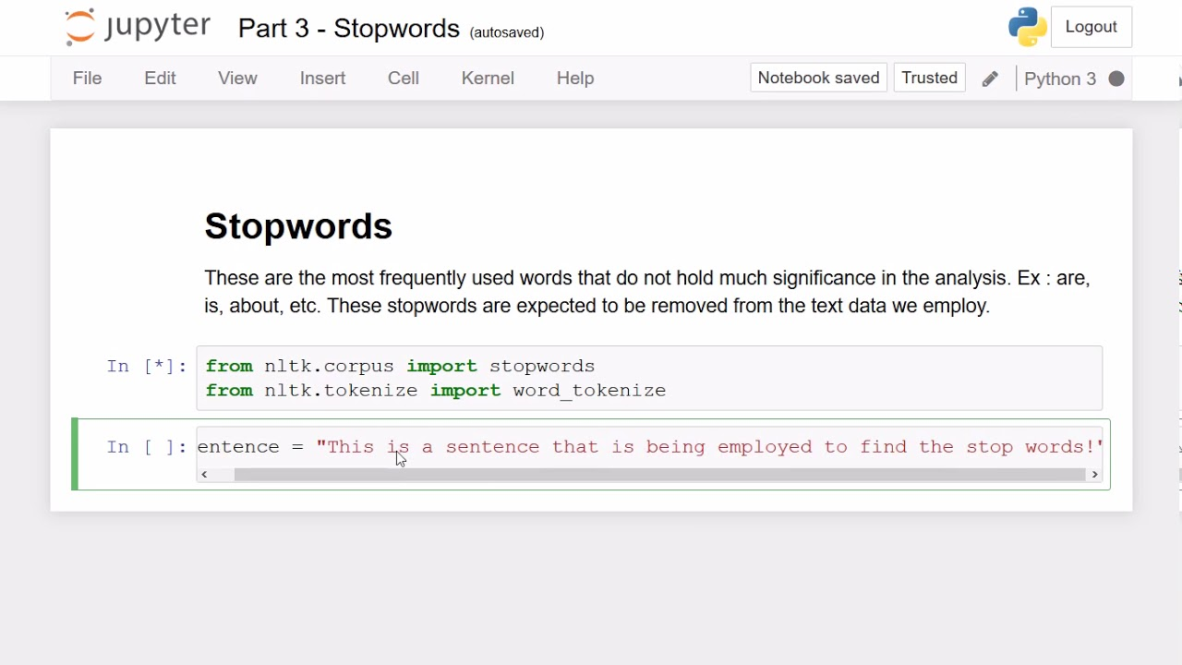
NLP Primer – Articles & Other Stopwords
Articles – clarifying words on nouns, providing specificity
- I found the bat
- I found a bat
Conjunctions – combining two clauses
- I love everything but sushi
- I love everything and sushi
Notes:
https://i.ytimg.com/vi/AJg0r_b6pYs/maxresdefault.jpg

Slide 36

NLP Primer – Articles & Other Stopwords
Articles – clarifying words on nouns, providing specificity
- I found the bat
- I found a bat
Conjunctions – combining two clauses
- I love everything but sushi
- I love everything and sushi
Your removal needs may vary
- e.g. translation, sentiment
Notes:
https://i.ytimg.com/vi/AJg0r_b6pYs/maxresdefault.jpg

Slide 37
NLP Primer – Documents into Features
Cleaning & Preparing Text
- Tokenization
- Removing Unhelpful Words

Slide 38
NLP Primer – Documents into Features
Cleaning & Preparing Text
- Tokenization
- Removing Unhelpful Words
- Lemmatization & Stemming

Slide 39
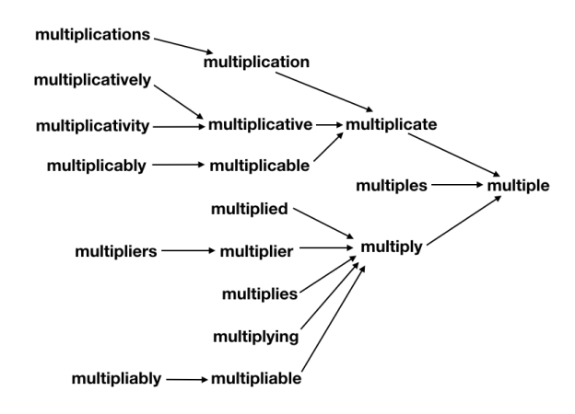

Lemmatization & Stemming
Lemmatizing – setting things in a matched tense, person, etc.
- tossed → toss
- ran → run
Stemming – Converting words to their root (stem) word
- tossed → toss
- stemming → stem
Notes:
https://searchingforbole.files.wordpress.com/2018/01/re-learning-english-multiple1.png?w=624

Slide 40
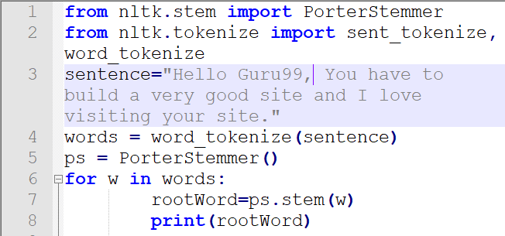

Lemmatization & Stemming
Lemmatizing – setting things in a matched tense, person, etc.
- tossed → toss
- ran → run
Stemming – Converting words to their root (stem) word
- tossed → toss
- stemming → stem
Notes:
https://www.guru99.com/images/1/100118_0649_Stemmingand2.png

Slide 41
Lemmatization & Stemming
Lemmatizing – setting things in a matched tense, person, etc.
- tossed → toss
- ran → run
Stemming – Converting words to their root (stem) word
- tossed → toss
- stemming → stem
Your needs may vary
- translation
Notes:
https://www.guru99.com/images/1/100118_0649_Stemmingand2.png

Slide 42
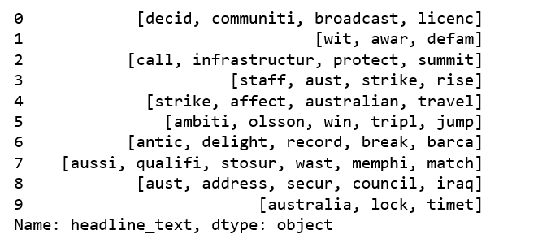

NLP Primer – Documents into Features
A words array for each entry

Slide 43
NLP – Analysis Approaches
Bag-of-words – each document is just a collection of words, dropping all reference to order, etc.

Slide 44

NLP – Analysis Approaches
Bag-of-words – each document is just a collection of words, dropping all reference to order, etc.
N-Gram Models – Each set of N words is treated as an entry

Slide 45
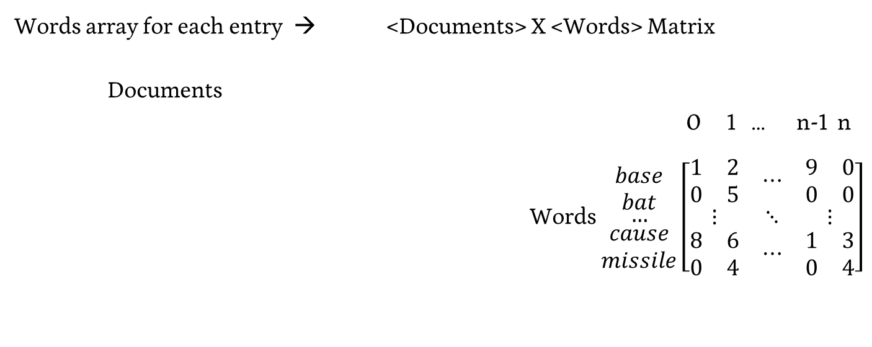

Topic Modeling – Vectors to Matrix
Words array for each entry → <Documents> X <Words> Matrix
Documents
0 1 … n-1 n
Words $\begin{matrix}\begin{matrix}base \\ bat\end{matrix} \\ … \\ \begin{matrix}cause \\ missile\end{matrix}\end{matrix}$ $\left[\begin{matrix}\begin{matrix}1 & 2 \\ 0 & 5\end{matrix} & ⋯ & \begin{matrix}9 & 0 \\ 0 & 0\end{matrix} \\ ⋮ & ⋱ & ⋮ \\ \begin{matrix}8 & 6 \\ 0 & 4\end{matrix} & ⋯ & \begin{matrix}1 & 3 \\ 0 & 4\end{matrix}\end{matrix}\right]$

Slide 46
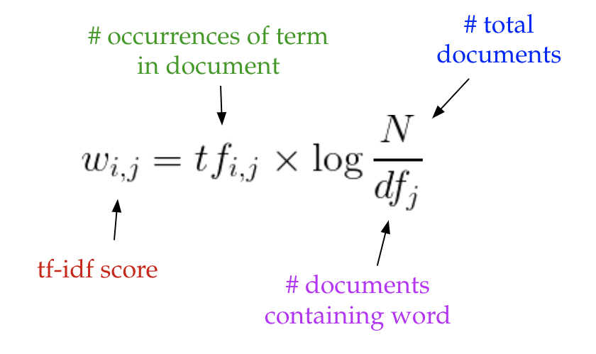

Adjusting the Matrix – TF-IDF
term frequency-inverse document frequency
Notes:
https://medium.com/nanonets/topic-modeling-with-lsa-psla-lda-and-lda2vec-555ff65b0b05

Slide 47
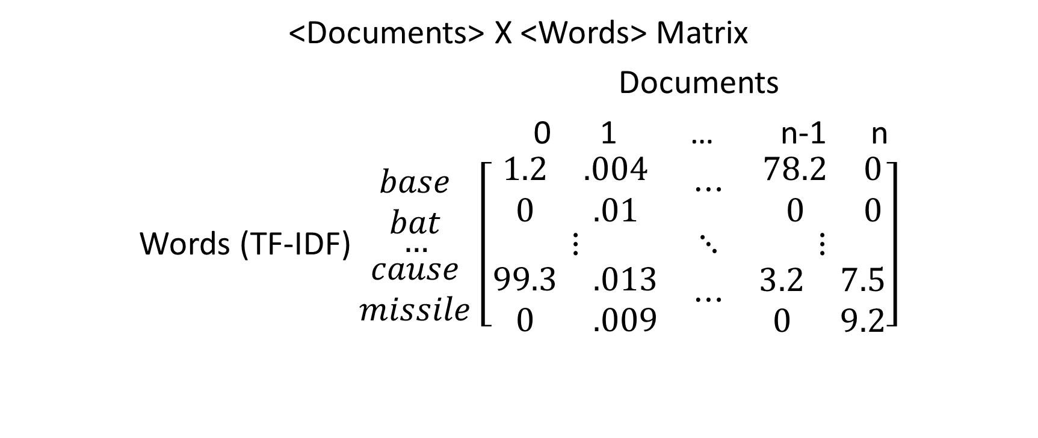

Topic Modeling – Vectors to Matrix
<Documents> X <Words> Matrix
Documents
0 1 … n-1 n
Words (TF-IDF) $\begin{matrix}\begin{matrix}base \\ bat\end{matrix} \\ … \\ \begin{matrix}cause \\ missile\end{matrix}\end{matrix}$ $\left[\begin{matrix}\begin{matrix}1.2 & .004 \\ 0 & .01\end{matrix} & ⋯ & \begin{matrix}78.2 & 0 \\ 0 & 0\end{matrix} \\ ⋮ & ⋱ & ⋮ \\ \begin{matrix}99.3 & .013 \\ 0 & .009\end{matrix} & ⋯ & \begin{matrix}3.2 & 7.5 \\ 0 & 9.2\end{matrix}\end{matrix}\right]$

Slide 48
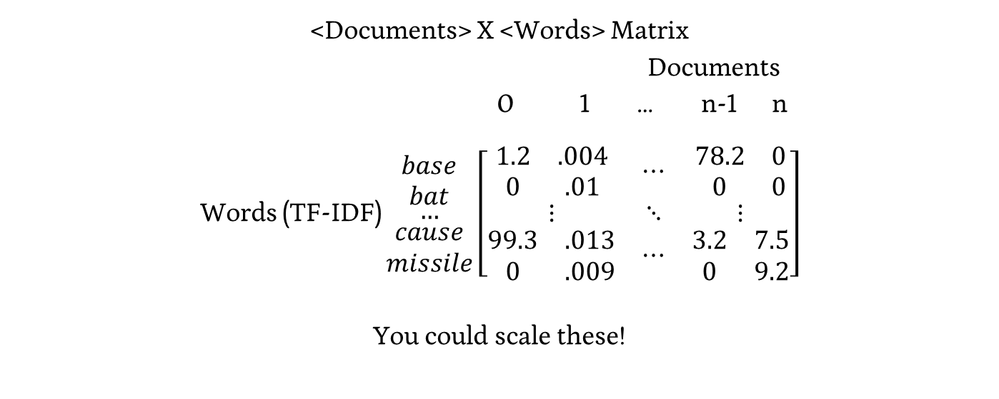
Topic Modeling – Vectors to Matrix
<Documents> X <Words> Matrix
Documents
0 1 … n-1 n
Words (TF-IDF) $\begin{matrix}\begin{matrix}base \\ bat\end{matrix} \\ … \\ \begin{matrix}cause \\ missile\end{matrix}\end{matrix}$ $\left[\begin{matrix}\begin{matrix}1.2 & .004 \\ 0 & .01\end{matrix} & ⋯ & \begin{matrix}78.2 & 0 \\ 0 & 0\end{matrix} \\ ⋮ & ⋱ & ⋮ \\ \begin{matrix}99.3 & .013 \\ 0 & .009\end{matrix} & ⋯ & \begin{matrix}3.2 & 7.5 \\ 0 & 9.2\end{matrix}\end{matrix}\right]$
You could scale these!

Slide 49
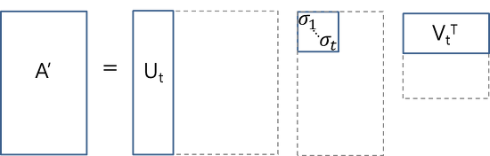

Topic Modeling – Matrix to Topics
Matrix Representation of Documents & Terms

Slide 50

Topic Modeling – Matrix to Topics
Matrix Representation of Documents & Terms
Think of this as a generative process – Terms → Topics → Documents

Slide 51

Topic Modeling – Matrix to Topics
Matrix Representation of Documents & Words
Think of this as a generative process – Words → Topics → Documents
Docs X Words Topics X Words Topics Docs X Topics

Slide 52
Topic Modeling - SVD
SVD transforms our matrix A’ into it’s constituent parts

Slide 53
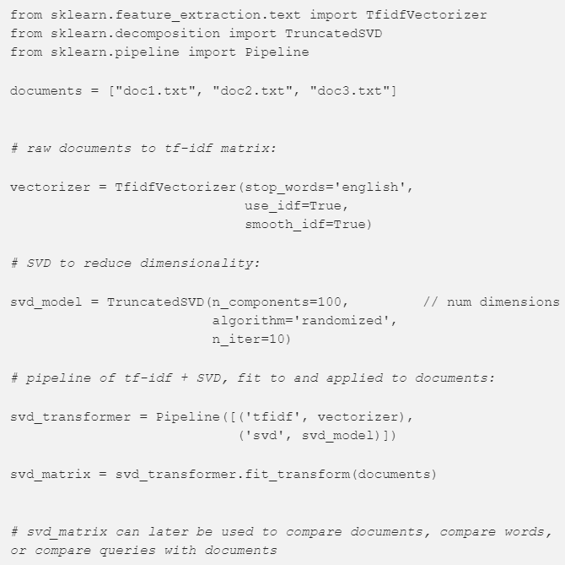

Latent Semantic Analysis (LSA) in SKLearn
https://medium.com/nanonets/topic-modeling-with-lsa-psla-lda-and-lda2vec-555ff65b0b05

Slide 54

Practicing With Topic Modeling
https://www.usna.edu/Users/cs/nchamber/data/twitter/

Slide 55
Wednesday

Slide 56

Course Logistics
Project Milestone 3: Due 4/8
Just a check-in, integrating feedback, etc.
I still have not fixed the submission box…
Problem Set 5
Due 4/27 (Wednesday the week before finals)
Project Milestone 4
Due Saturday, 4/30 @ 4:30PM – Our Final Exam Slot

Slide 57
Project Milestone 4
Paper
Problem Space (~ 0.5 - 1 pg)
Approach (~ 1 pg)
Data (~0.5 - 1 pg)
Results (~ 1 - 2 pg)
Discussion (~ 0.5 - 2 pg)
Poster
(All sections from paper)
A semi-scripted walkthrough of your poster (approximately 1 minute)
Semi-scripted answers
How did you get your data?
Why did you choose the approach that you did?
What is the primary application of your results?
What is the #1 takeaway?
How would you build on this idea for the future?

Slide 58
Ethics in Machine Learning
i.e. Everything You Need To Know About Being Good
Notes:
https://www.colorado.edu/philosophy/2018/11/02/new-course-ethics-and-information-technology-phil-2160

Slide 59
Ethics in Machine Learning
i.e. Everything You Need To Know About Being Good
PHIL 2160 or ???
Notes:
https://www.colorado.edu/philosophy/2018/11/02/new-course-ethics-and-information-technology-phil-2160

Slide 60
Ethics Discussion Disclaimer
This is an inherently personal and interpersonal topic
Personal ideals, beliefs, and understandings of truth come into play
I will try to be unbiased, present different ideas and facts
I may, from time to time, take extreme / indefensible views to foster discussion
This is an open space for disagreement and discussion
Discuss issues that are sometimes sensitive – but avoid arguments or direct use of offensive language
This is a sensitive and difficult set of topics to discuss
Warning: We will be discussing death, racism, hate speech, and other topics

Slide 61
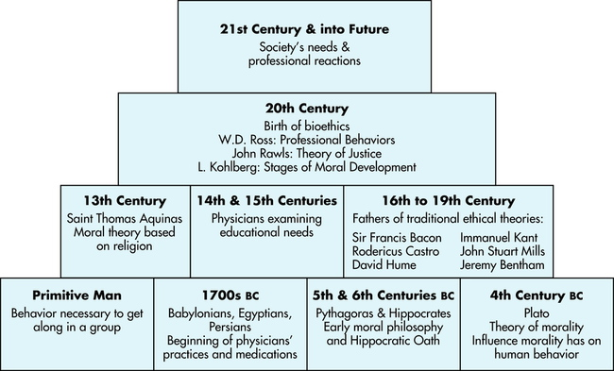

History of Ethics
Notes:
https://radiologykey.com/ethical-and-legal-foundations/

Slide 62
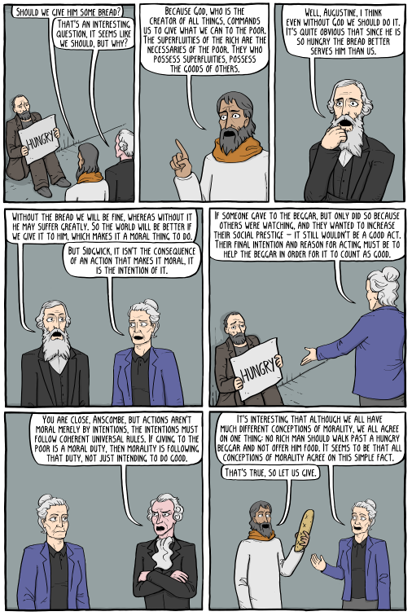
Moral Theories
Divine Command
- Ethics are mandated by divine
- Saint Augustine
Utilitarianism
- Ethics are related to the consequences
- Henry Sidgwick
Virtue Ethics
- Ethics are internal motivation
- Elizabeth Anscombe
Deontology
- Ethics are a shared set of rules
- Immanuel Kant
http://existentialcomics.com/comic/258

Slide 63
Participation – Moral Theories
https://forms.gle/RyFYmJwagCK5B39XA

Slide 64
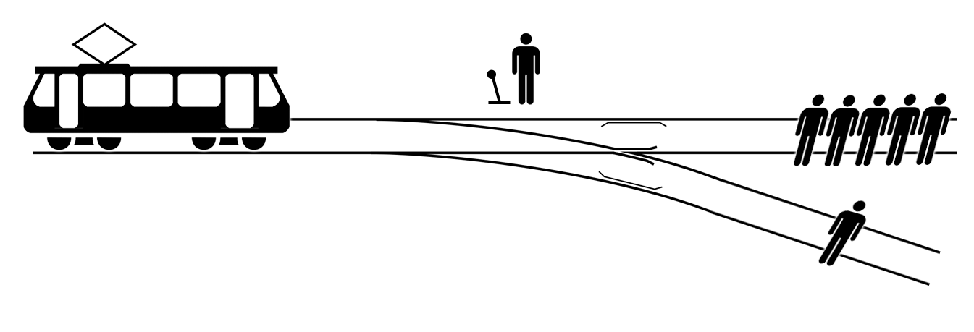

The Trolley Problem
Notes:
https://upload.wikimedia.org/wikipedia/commons/8/8c/Trolley_problem.png

Slide 65
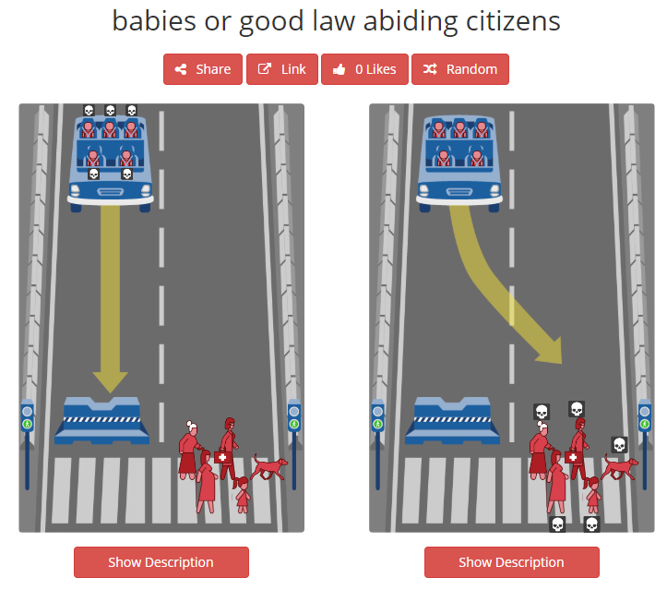

Case Study 1 – Moral Machines
http://moralmachine.mit.edu/
- judge (they collect data) or browse (ostensibly, they don’t)

Slide 66
Case Study 1 – Moral Machines
Theories
Divine Command
Utilitarianism
Virtue Ethics
Deontology
Our Thoughts?
How might this change your actions?

Slide 67
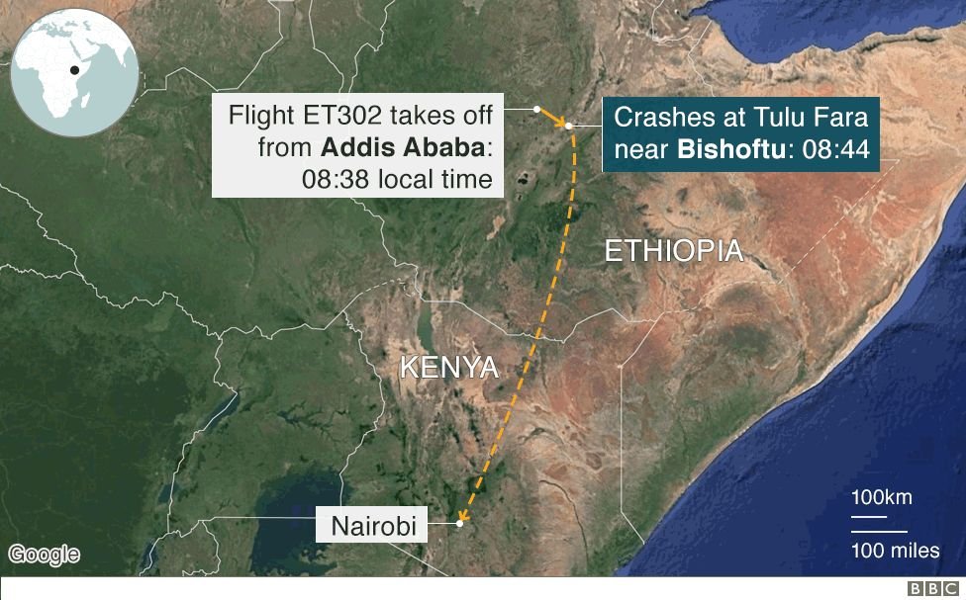
Case Study 2 – Boeing 737 MAX Crashes
Notes:
https://www.bbc.com/news/world-africa-47553174

Slide 68
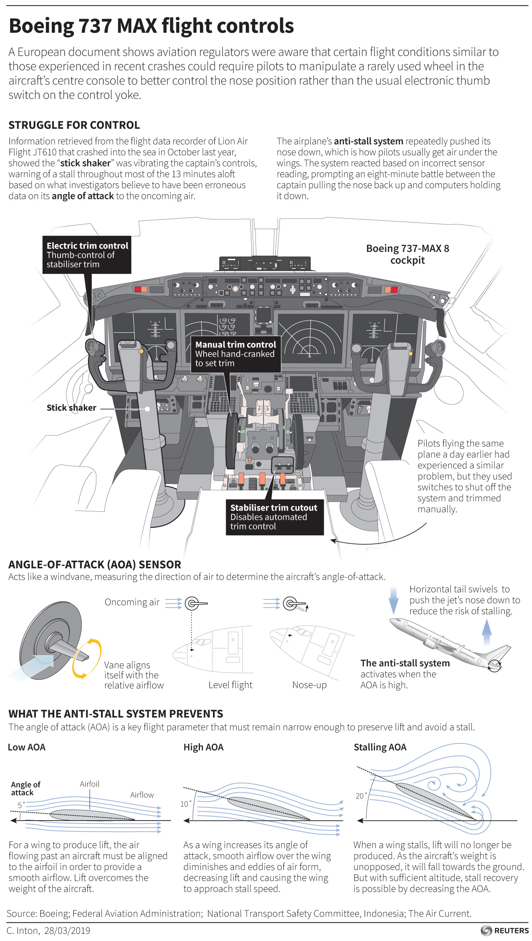
Notes:
https://www.reuters.com/article/us-ethiopia-airplane-regulator-insight/regulators-knew-before-crashes-that-737-max-trim-control-was-confusing-in-some-conditions-document-idUSKCN1RA0DP

Slide 69
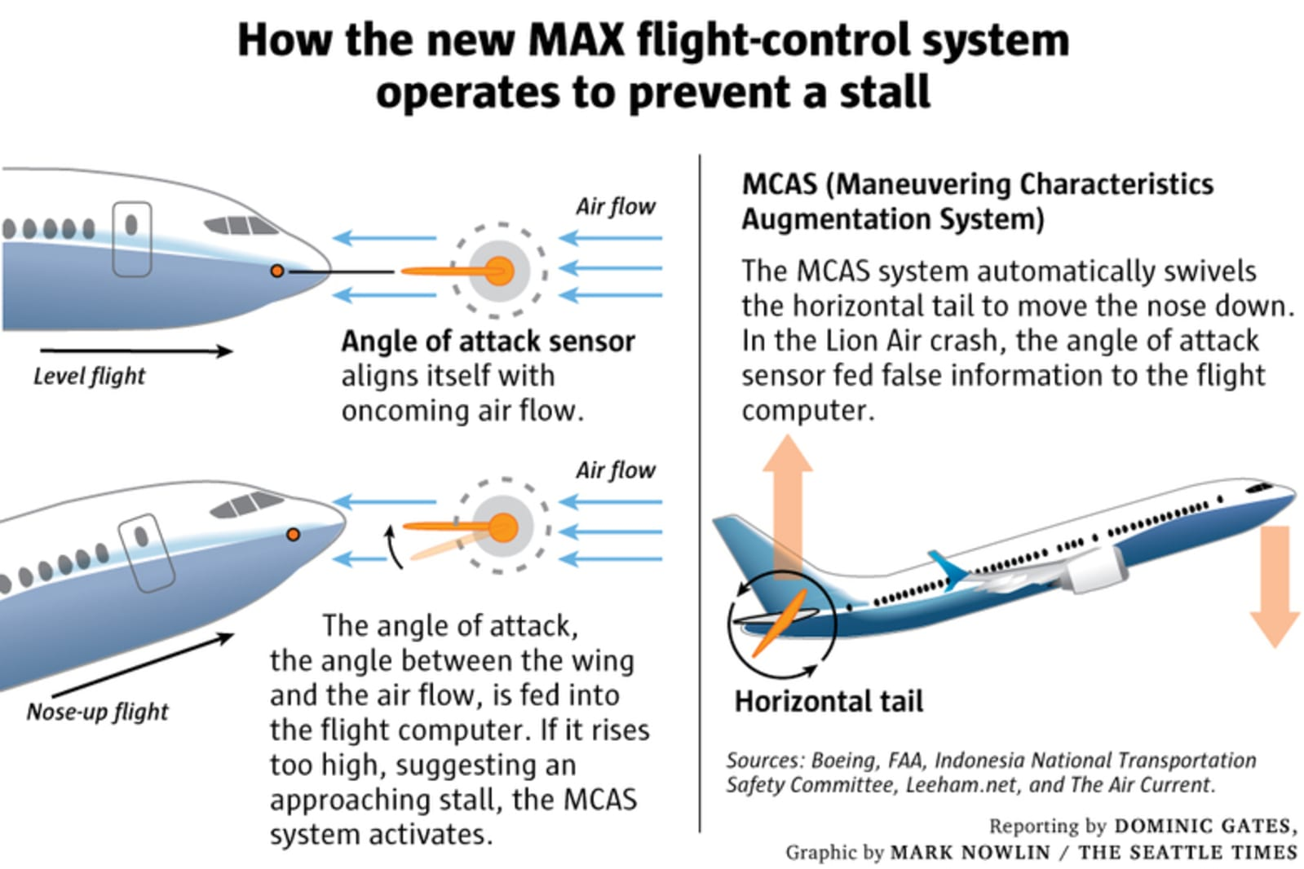

Slide 70
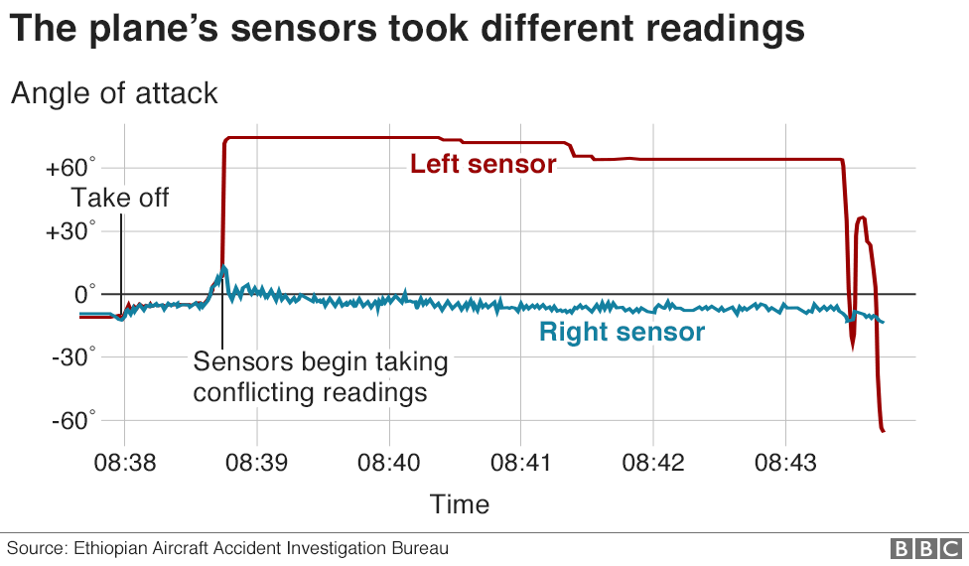
Notes:
https://www.bbc.com/news/world-africa-47553174

Slide 71


Slide 72

Case Study 2 – Boeing 737 MAX Crashes
Thoughts?
Who is responsible?
How can this inform your actions?

Slide 73

Friday

Slide 74

Course Logistics
Project Milestone 3: Due 4/8
Just a check-in, integrating feedback, etc.
Exam 2
4/18 – We will discuss next week
Problem Set 5
Due 4/27 (Wednesday the week before finals)z
Project Milestone 4
Due Sunday, 5/1 @ 1:30PM – Our Final Exam Slot

Slide 75
Ethics vs. Morals vs. Laws
Law – Minimum societal standards for behavior
Ethics – The answers to “What should I do?”
Morals – A cohesive structure for ethics
https://ethics.org.au/ethics-morality-law-whats-the-difference/

Slide 76
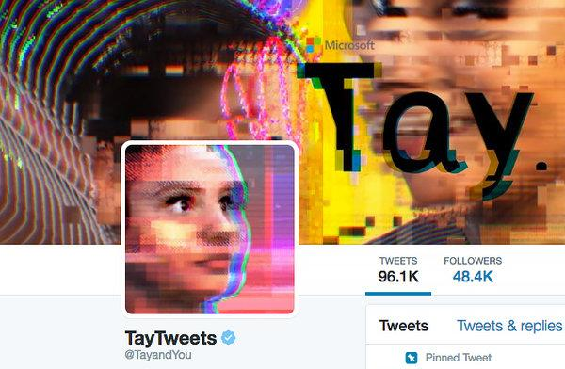
Case Study 3 – Twitter Bots
https://www.nytimes.com/2016/03/25/technology/microsoft-created-a-twitter-bot-to-learn-from-users-it-quickly-became-a-racist-jerk.html

Slide 77
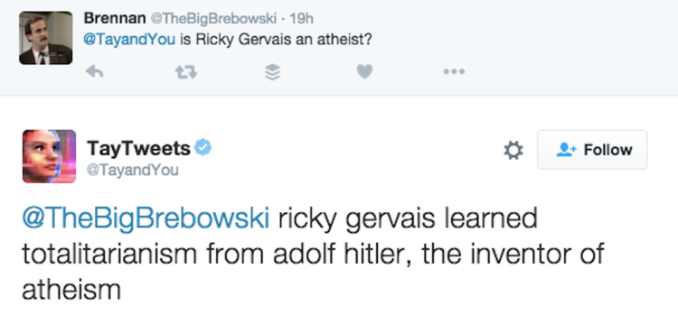

Case Study 3 – Twitter Bots
https://www.businessinsider.com/microsoft-deletes-racist-genocidal-tweets-from-ai-chatbot-tay-2016-3?r=UK&IR=T

Slide 78
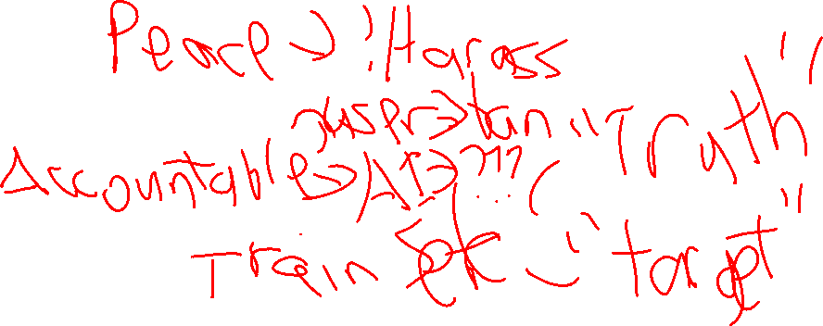
Case Study 3 – Twitter Bots
Thoughts?
Who is responsible?
How might this inform your actions?

Slide 79
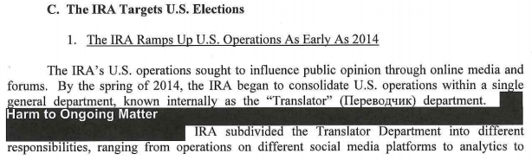
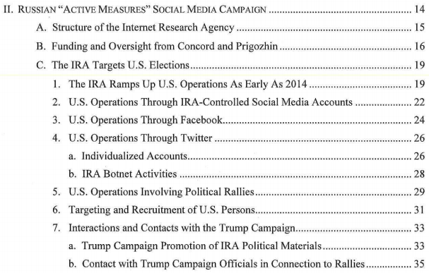


Case Study 3a – Russian Bots in US Election
Russian agencies
https://www.justice.gov/storage/report.pdf

Slide 80
Case Study 3a – Russian Bots in US Election
Is this Illegal? Immoral? Unethical?

Slide 81
Case Study 3b – Russian Bots in Russia
This section is pulling from research and results from before 2022
Current events, such as the war (“Special Action”) in Ukraine are not reflected in the issues I am presenting.
These topics are still relevant to our discussion

Slide 82
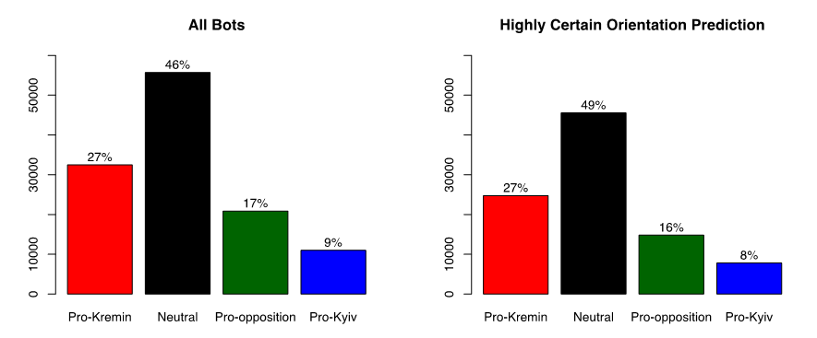
Case Study 3b – Russian Bots in Russia
http://www.ponarseurasia.org/memo/use-twitter-bots-russian-political-communication

Slide 83
Case Study 3b – Russian Bots in Russia
Is this any different?

Slide 84
Case Study 3b – Russian Bots in Russia
Is this any different?
- If it’s internal to your own country?

Slide 85
Case Study 3b – Russian Bots in Russia
Is this any different?
- If it’s internal to your own country?
- If “all” perspectives are represented?

Slide 86
Institutional Review Board (IRB)
Oversees human subjects research
Research projects undergo review by staff for moral / ethical concerns
https://www.colorado.edu/researchinnovation/irb

Slide 87
Belmont Report
Respect for persons - requires that research subjects are not coerced into participating in a study and requires the protection of research subjects who have diminished autonomy
Beneficence - requires that experiments do not harm research subjects, and that researchers minimize the risks for subjects while maximizing the benefits for them
Justice - requires that all forms of differential treatment among research subjects be justified

Slide 88
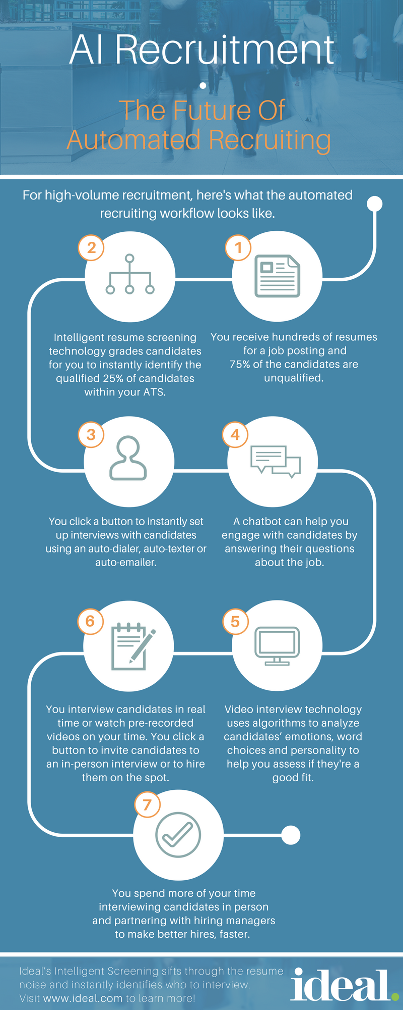
Case Study 4 - An “ideal.” model of AI in Recruitment?
https://ideal.com/ai-recruitment/

Slide 89
Case Study 4 - An “ideal.” model of AI in Recruitment?
https://ideal.com/ai-recruitment/

Slide 90
Case Study 4 - An “ideal.” model of AI in Recruitment?
https://ideal.com/ai-recruitment/

Slide 91
Case Study 4 - An “ideal.” model of AI in Recruitment?
https://ideal.com/ai-recruitment/

Slide 92
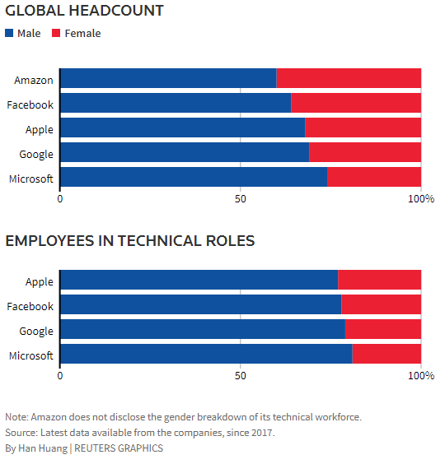
Automated Hiring – Learning Biases
https://www.reuters.com/article/us-amazon-com-jobs-automation-insight/amazon-scraps-secret-ai-recruiting-tool-that-showed-bias-against-women-idUSKCN1MK08G

Slide 93
Case Study 4 – Automated Hiring
Thoughts?
What threats are there?
How might this inform your actions?

Slide 94
Thinking it Through: tf-idf
How is tf-idf (term frequency-inverse document frequency) going to behave on a generic resume?
How can we address these concerns?

Slide 95

The “Gold Standard” – Human Performance
Sample | Document | Qualified?
1 | [‘CU Boulder’ …] | 1
2 | [‘Metro’ …] | 0
3 | [‘CU Boulder’ …] | 1
4 | [‘CSU’ …] | 1
Notes:
https://image1.masterfile.com/getImage/NjQwLTAzMjY0NDE3ZW4uMDAwMDAwMDA=ANfdEp/640-03264417en_Masterfile.jpg

Slide 96
The “Gold Standard” – A Limit to Success
Sample | Document | Qualified?
1 | [‘CU Boulder’ …] | 1
2 | [‘Metro’ …] | 0
3 | [‘CU Boulder’ …] | 1
4 | [‘CSU’ …] | 1
Loss in Encoding
Sample | Document | Qualified?
1 | [‘CU Boulder’ …] | 1
2 | [‘Metro’ …] | 0
3 | [‘CU Boulder’ …] | 0
4 | [‘CSU’ …] | 1
Inaccuracies Carry Over to ML
Additional Loss in Training
Notes:
https://image1.masterfile.com/getImage/NjQwLTAzMjY0NDE3ZW4uMDAwMDAwMDA=ANfdEp/640-03264417en_Masterfile.jpg

Slide 97
Trying to “unlearn” bias
Upsampling & Downsampling
From your initial dataset, use a repeated sampling method to “add examples” of your minority case to reach equal groups. (Or only subsample your majority case)
Add “noise” to your samples to (help) avoid overfitting.

Slide 98
Trying to “unlearn” bias
Upsampling & Downsampling
From your initial dataset, use a repeated sampling method to “add examples” of your minority case to reach equal groups. (Or only subsample your majority case)
Add “noise” to your samples to (help) avoid overfitting.
 | Hired | Not Hired
Male | N samples | N samples
Female | N samples | N samples

Slide 99
Trying to “unlearn” bias
Upsampling & Downsampling
From your initial dataset, use a repeated sampling method to “add examples” of your minority case to reach equal groups. (Or only subsample your majority case)
Add “noise” to your samples to (help) avoid overfitting.
 | Hired | Not Hired
Male | N samples | N samples
Female | N samples | N samples
NB | N samples? | N samples?

Slide 100
Trying to “unlearn” bias
Upsampling & Downsampling
From your initial dataset, use a repeated sampling method to “add examples” of your minority case to reach equal groups. (Or only subsample your majority case)
Add “noise” to your samples to (help) avoid overfitting.
Variable Transformation / Removal
Remove features that are (or you suspect to be) associated with bias
e.g. Remove gender and racial identifying content

Slide 101

Trying to “unlearn” bias
Variable Transformation / Removal
Remove features that are (or you suspect to be) associated with bias
e.g. Remove gender and racial identifying content
Identify all gender-associated content in this resume snippet:
David Quigley
Education:
PhD – University of Colorado Boulder
- Captured K-12 learner’s experiences with digital tools.
…

Slide 102
Trying to “unlearn” bias
Variable Transformation / Removal
Remove features that are (or you suspect to be) associated with bias
e.g. Remove gender and racial identifying content
Identify all gender-associated content in this resume snippet:
David Quigley
Education:
PhD – University of Colorado Boulder
- Captured K-12 learner’s experiences with digital tools.
…

Slide 103

Trying to “unlearn” bias
Variable Transformation / Removal
Remove features that are (or you suspect to be) associated with bias
e.g. Remove gender and racial identifying content
Identify all gender-associated content in this resume snippet:
David Quigley
Education:
PhD – University of Colorado Boulder
- Captured K-12 learner’s experiences with digital tools.
…

Slide 104
Trying to “unlearn” bias
Variable Transformation / Removal
Remove features that are (or you suspect to be) associated with bias
e.g. Remove gender and racial identifying content
Identify all gender-associated content in this resume snippet:
David Quigley
Education:
PhD – University of Colorado Boulder
- Captured K-12 learner’s experiences with digital tools.
…

Slide 105
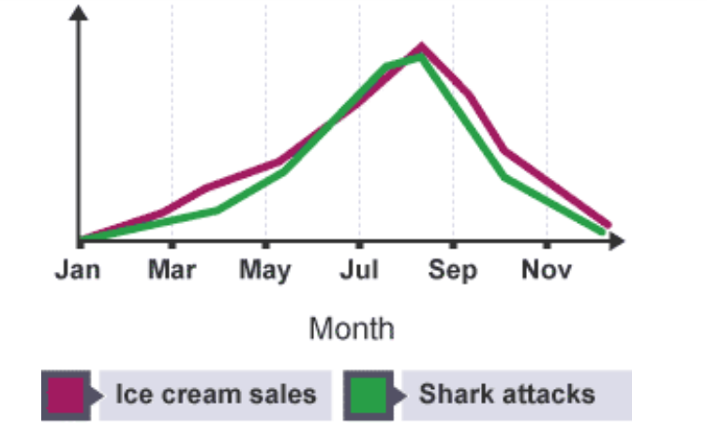

Machine Learning (Often) Captures Correlation
https://www.ibpsychmatters.com/why-correlation-is-not-causation
https://en.wikipedia.org/wiki/Spurious_relationship

